Slide 1
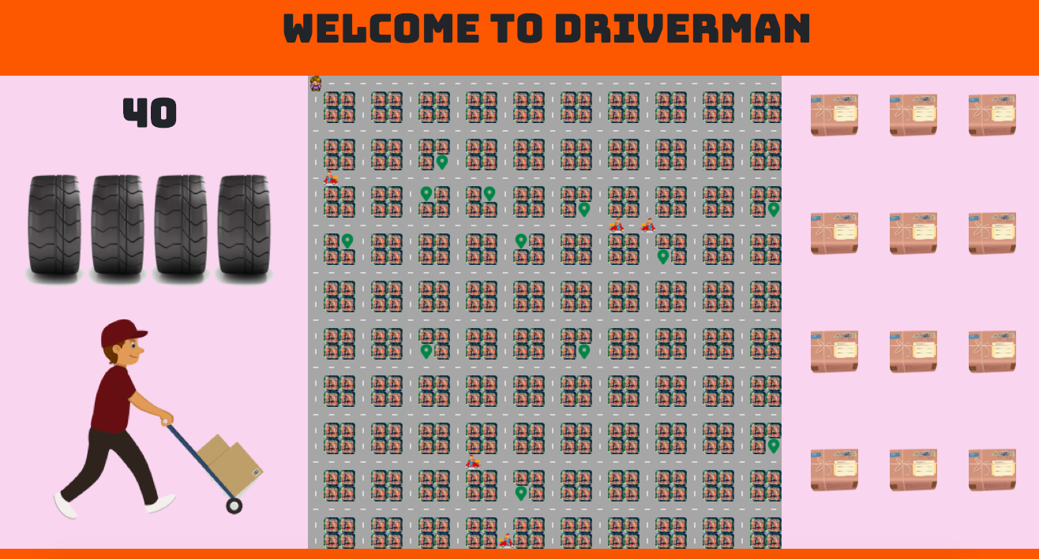

Slide 2
HELLO ALL!
My name is Gonzalo
It’s like Gonzalez but….
…no…
GONZALO actually

Slide 3
I have worked for years in the LAST MILE DELIVERY BUSINESS
so…

Slide 4

I created ¡DRIVER MAN!

Slide 5
400 JAVASCRIPT
35 HTML
182 CSS
50 JQUERY

Slide 6
One challange: CREATING THE MAP

Slide 7
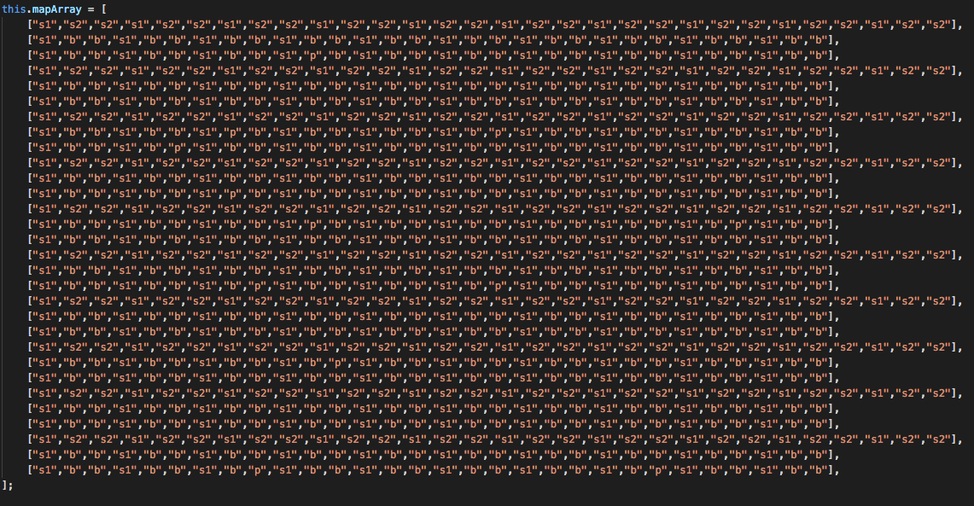
One challange: CREATING THE MAP

Slide 8

THAT’S ALL FOLKS

